Slide 1
hate speech on twitter

Slide 2
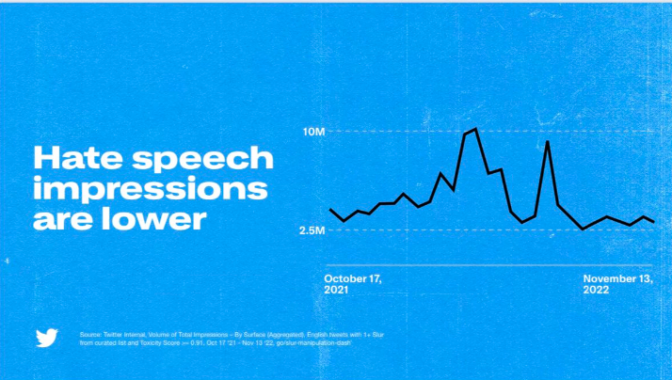
What’s the problem?
Elon Musk took over twitter on the 27th October 2022
He has fired half the workforce, further staff have quit following demands to be ‘hardcore’ and he has visions for the company to allow greater free speech
Since his take over he has claimed that:

Slide 3
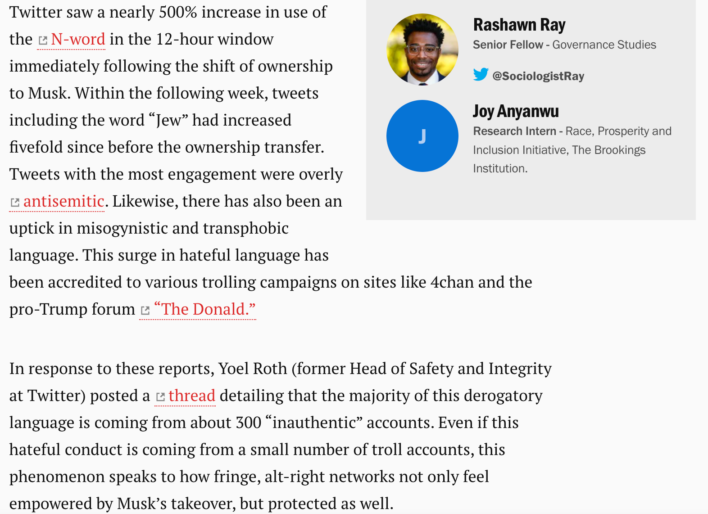
This claim is not backed up by external analysis

Slide 4
Proposed Analysis
Hate speech definition:
Offensive discourse targeting a group or an individual based on inherent characteristics (such as race, religion or gender)
Development of a model that detects hate speech on twitter
Adaptation of this model for other platforms
Comparison of change in hate speech detection over the same time period

Slide 5
Further analysis
Who is the hate speech coming from?
Has the spike observed been sustained?
What kind of hate speech is being used on the different platforms? How does this differ by platform?
How accurate is the model in comparison with other models out there?

Slide 6
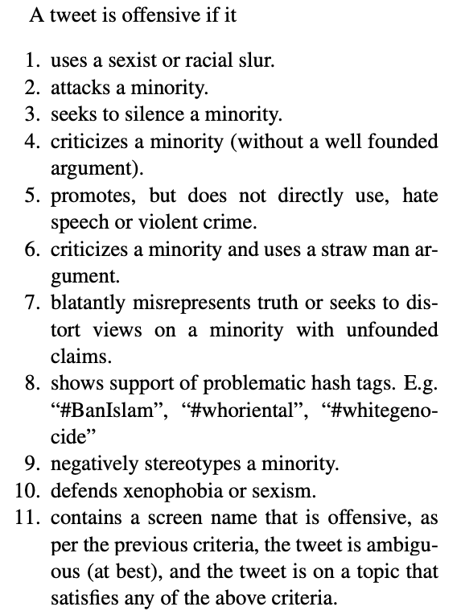
Choice of training data
Sourced a training dataset from hatespeechdata.com with advice from: https://towardsdatascience.com/how-to-create-your-own-hate-tweet-detector-704508c34cd0
Hateful Symbols or Hateful People? Predictive Features for Hate Speech Detection on Twitter.
Waseem and Hovy annotated 16k tweets themselves, with verification from a female gender studies student
Large Scale Crowdsourcing and Characterization of Twitter Abusive Behavior
Crowdsourcing annotation, up to 20 per tweet
Hate Speech and Offensive Content Identification in Indo-European Languages
A variety of tasks mostly LSTM networks

Slide 7
What kind of tools and packages?
Build a model using:
NLTK – Natural Language Toolkit
ANN – Aim to use neural networks to create a model, but will compare to logistic regression and other ways to classify data
Run the tools on a sample of data from twitter and reddit between 1st August 2022 and 1st December 2022

